Slide 1
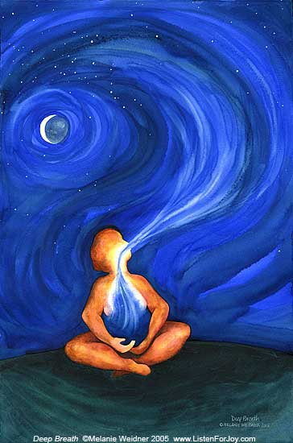
Breath of Life: Tricks to Master Mechanical Ventilation
Nicholas Spartan Santavicca, MD
Emergency Medicine, Internal Medicine, Critical Care
Montefiore Medical Center

Slide 2
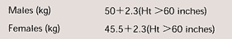
Goals of Mechanical Ventilation
Goals of Oxygenation (PEEP, FiO2)
SpO2 88 – 95%
PaO2 55 – 80mmHg
FiO2 < 60%
Goals of Ventilation (TV, RR)
6 – 8cc/kg IBW
pH ~ 7.25 – 7.3
Goals of Mechanics
Driving pressure (DP) < 14cm H2O
Pplat < 30cm H20
PIP < 40cm H2O if possible
Synchronous flow loops
Notes:
Talk about titrate oxygenation via PEEP and FiO2.
Ventilation via TV and RR.

Slide 3
Remember…
PIP, Pplat relationship
PIP > Pplat → think obstruction, increased resistance
PIP ≈ Pplat → think worsening compliance, stiffer lungs
Look at wave forms
Exhalation curve should return to baseline
Inhalation pressures should be linear or flat

Slide 4
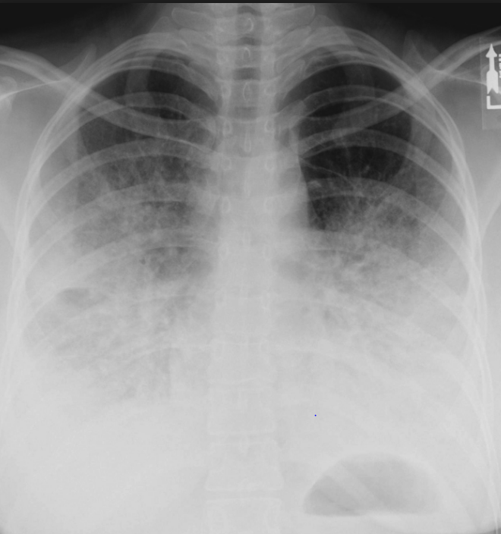
Case 1
42yo F p/w 3 days of worsening cough and SOB
RR 38 and 82% on RA
On HFNC, RR 32, 88% and increased WOB

Slide 5
Case 2
63 yo M hx COPD on 3L home O2 p/w worsening shortness of breath
Drowsy, RR 34, no air movement throughout
ABG 7.12 / >100 / 75
Tried on BiPAP for 30 min without improvement

Slide 6
Case 3
Do Not Intubate
73yo M hx COPD p/w shortness of breath after running out of meds x 2 weeks
RR 30, O2 sat 88% on 2L
Diminished breath sounds throughout
7.32 / 87 / 69
Notes:
ACUTE: every 10 increase in CO2, pH drops 0.08 or HCO3 increases by 1
CHRONIC: every 10 increase in CO2, pH drops 0.03 and HCO3 increases by 3.

Slide 7
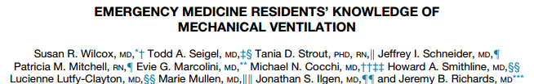
> 85% had < 5 hours education in past year
90% > 1 intubated patient / month
60% > 4 patients / month
>40% do not feel comfortable
>75% by RT
Notes:
Surveyed residents regarding training and comfort with mechanical ventilation.
Primarily surveyed North eastern US – 312 EM residents.

Slide 8
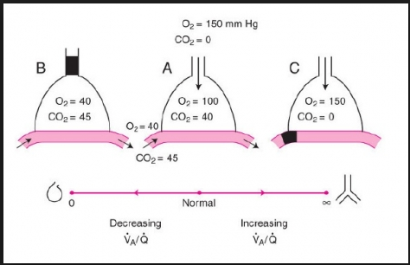
Respiratory Failure
Type 1 (hypoxic)
V/Q mismatch
Low barometric pressure (Mt. Everest)
Low FiO2 (Scuba diving, space)
Diffusion impairment (ILD, IPF)
Alveolar hypoventilation (Baltimore)
Shunt
Dead Space

Slide 9
Respiratory Failure
Type 2 (hypercapnic)
Hypoventilation (Baltimore)
Increased dead space
Increased CO2 production
Type 3 (mixed)

Slide 10
Positive Pressure Ventilation
What it does?
Decreases WOB
Restores gas exchange
Notes:
We have to remember to treatment for respiratory failure is positive pressure ventilation (both invasive, noninvasive).
They do this, in broad strokes by decreasing WOB and restoring gas exchange by recruiting better lung and improving mechanics.
There are, just like any treatment in medicine, some downsides and risks involved.
As you push air into the lungs, completely flip pressure gradients from normal physiology (spontaneous breathing is negative pressure system)
- By breathing via positive pressure, you decrease venous return (in preload dependent states (RV failure – submassive/massive PE, tamponade, RV failure/pHTN exacerbation.

Slide 11
Positive Pressure Ventilation
Risks
Preload dependent states
Under-resuscitated
RV failure
PE, pHTN exacerbation, MI
Tamponade
Thoracic compartment syndrome
Lung damage
Notes:
There are, just like any treatment in medicine, some downsides and risks involved.
As you push air into the lungs, completely flip pressure gradients from normal physiology (spontaneous breathing is negative pressure system)
- By breathing via positive pressure, you decrease venous return (in preload dependent states (RV failure – submassive/massive PE, tamponade, RV failure/pHTN exacerbation.

Slide 12
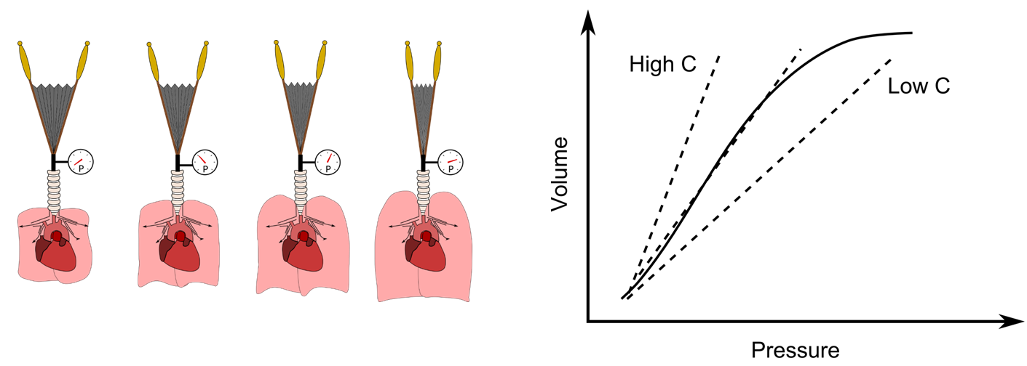
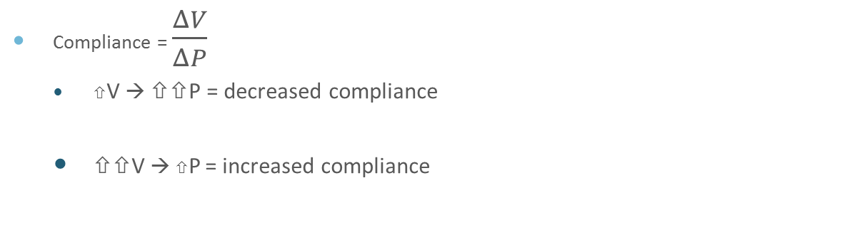
Compliance
Compliance = $\frac{ΔV}{ΔP}$
V → P = decreased compliance
V → P = increased compliance
COPD
ARDS
Notes:
Think of this as the EF of the lung

Slide 13
Inspiration
Trigger (initiates inspiration)
Patient effort – Assisted breath
Machine effort – Controlled breath
Target (cannot be exceeded)
Set flow
Set inspiratory pressure
Cycle (terminates inspiration)
Set volume
Set inspiratory time
Notes:
Inspiration is what we control during mechanical ventilation. We control the time and amount of pressures/flows involved during expiration.

Slide 14

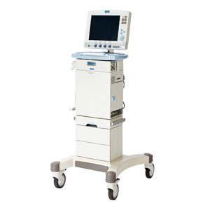
Expiration
Purely passive
Based on
Expiratory time
Obstruction
Can adjust based on flow and RR

Slide 15
Example of respiratory phases
RR 15 BPM
Respiratory cycle = insp + expiratory times
60/15 = 4s
Ins time (we set) – usually 0.8 to 1.2s
i.e. 1s
Expiration = resp cycle – insp
4s – 1s = 3s

Slide 16
Types of breathing
Pressure cycled modes – fixed pressure at variable volumes
CPAP
BiPAP
Pressure Support
Assist Control (PCAC)
Volume cycled modes – fixed volume at variable pressures
Assist Control (VCAC)
Intermittent Mandatory Ventilation (IMV)
Synchronous Intermittent Mandatory Ventilation (SIMV)
Pressure Regulated Volume Control

Slide 17
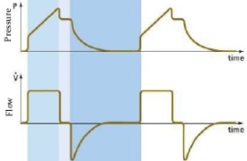
Volume control
We set:
Tidal Volume, iflow
RR
PEEP
FiO2
I:E (indirectly)
We evaluate:
PIP
Pplat
MV
Notes:
Important when need to ensure ventilation.
Constant flow → over certain designated time.
Rise in pressure to overcome ETT and proximal airways → then see rise in pressure in linear fashion as lungs become inflated (related to compliance of lungs). Then at end of breath, if perform inspiratory hold, resistance pressure (prox airways/ETT) becomes 0 and pressure is reflected as Pplat.

Slide 18
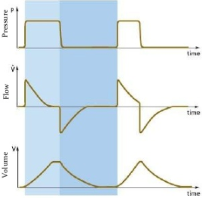
Pressure Control
We set:
PIP
PEEP
RR, Inspiratory time
FiO2
We evaluate:
TV
I:E ratio
Notes:
Need to be cautious when compliance is changing.

Slide 19
PC vs. VC
 | Pressure Control | Volume Control
Tidal Volume | Variable | We set
PIP | We set | Variable
Pplat | We set | Variable
Flow | Variable | We set
Flow pattern | Decelerating | We set

Slide 20
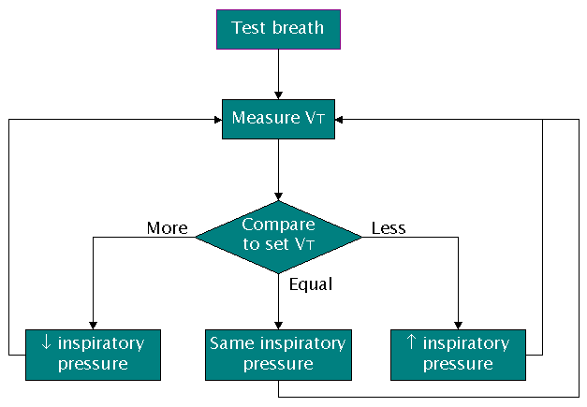
PRVC
Uses minimal pressure to achieve set volume
Adapts, varies pressures due to changing compliance
Tries to adapt to changing resistance, compliance
More comfortable
Decelerating flow pattern
Can receive high inspiratory flows
Harmful when agitated, dyssynchrony
Thinks patient doing more work
Notes:
Set your target TV and maximum Pressure.

Slide 21
Case 1
42yo F p/w 3 days of worsening cough and SOB
RR 38 and 82% on RA
Intubated with 6.0 ETT
ABG 7.32 / 48 / 156 on 100 % FiO2
Notes:
Want to go back to case 1 – clearly a hypoxic (T1 ) respiratory failure.
So we decide to intubate him. We see there is an 6.0 ETT tube. When we ask why, they say it is what we have.
According to Berlin criterial, moderate ARDS

Slide 22

Notes:
ARDS is not good lung, bad lung but a spectrum of diseased lung. Think of it like stroke and brain. You have diseased lung completely not participating in gas exchange and a small amount of good lung totally efficient and a good proportion acting like the prenumbra that could be salvageable. To do this we need to limit Ventilator induced lung injury and not shoot ourselves in the foot.
By following these goals, limit ventilator-induced lung injury

Slide 23
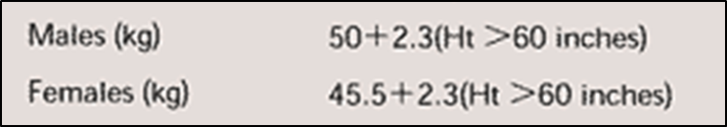
Goals of Mechanical Ventilation
Goals of Oxygenation
SpO2 88 – 95%
PaO2 55 – 80mmHg
FiO2 < 60%
Goals of Ventilation
6 – 8cc/kg IBW
pH 7.25 – 7.3
Goals of Mechanics
Driving pressure (DP) < 14cm H2O
Pplat < 30cm H20
PIP < 40cm H2O if possible
Synchronous flow loops
Notes:
You want to keep in mind when dealing with ARDS because these parameters limit VILI.

Slide 24
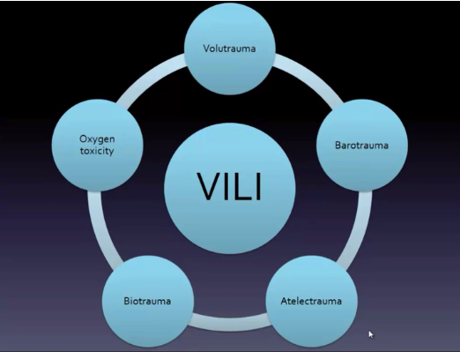
Notes:
Volutrauma – overdistension – as with high TV ventilation
Barotrauma – high peak pressures
Atelectrauma – opening and closing of alveoli
Biotrauma – caused by dyssynchrony
Oxygen toxicity – theoretical from 60% is ok, but known that excess O2 is harmful.

Slide 25
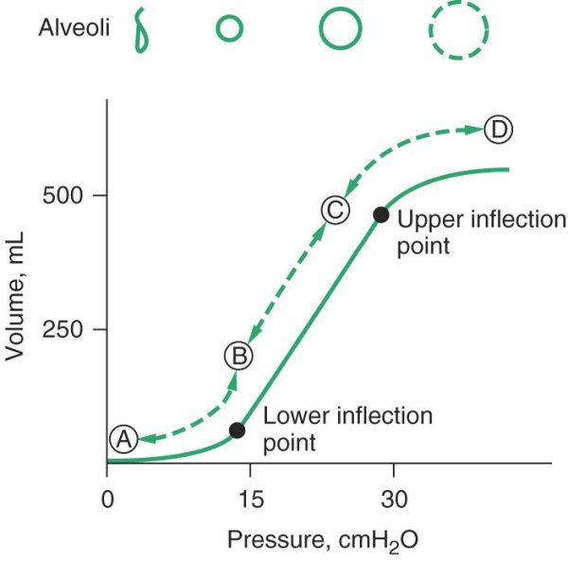
Volutrauma
Barotrauma
Atelectotrauma
Notes:
Pressure volume loops of alveoli. Think of this as the Frank Starling curve of the lung.

Slide 26
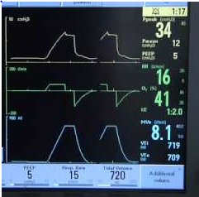
Case 1
PRVC 400 / 15 / 5 / 40
Called to room due to vent alarm
PIP continued to be 45
What else do you want to know?
Pplat is 26
What does this mean?
45

Slide 27
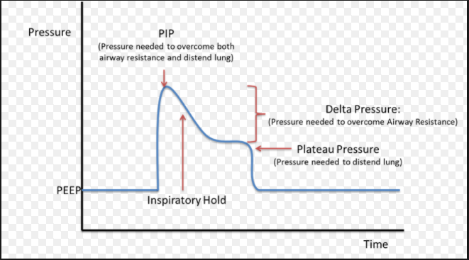
PIP > Pplat
ΔP = Driving pressure = Pplat – PEEP
ΔP = (Flow x resistance) + (TV/Compliance)
Resistance pressure
Elastic pressure
ETT, proximal airways
Notes:
Flow x resistance is dynamic component of breath (based on resistance of airways)
Tv, compliance is representative of the state of the lung parenchyma.

Slide 28
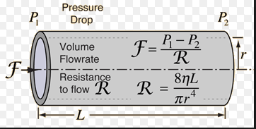
Peak > Plateau
⇧ resistance
ΔP = (Flow x resistance) + (TV/Compliance)
ΔP = (Flow x resistance)
Poiseuille’s Law
Notes:
Why do we care about this stuff?

Slide 29
PIP > Pplat
Size of ETT
Consider tube exchange
Obstruction (mucus plug, biting tube, kink)
Suction
Bronchoscopy?
Increase PEEP – blowout
Pull the tube!?
Bronchospasm
bronchodilators

Slide 30
Case 1
Exchange tube to 8.0 ETT
1hr later, called into room due vent alarm again
What else you want to know?
Pplat 35
What does this mean?
38

Slide 31
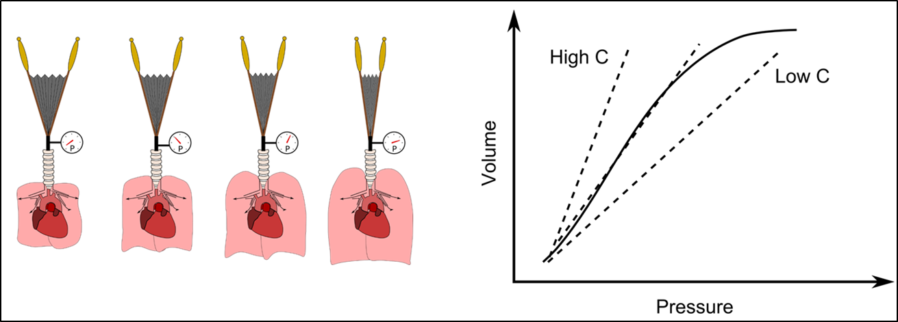
Peak ≈ Plateau
⇧ PIP ≈ Pplat ( compliance)
P = (Flow x resistance) + (TV / Compliance)
ΔP = (TV / Compliance)
Notes:
Why do we care about this stuff. Because

Slide 32
Peak and Plateau
PIP ~ Pplat
ARDS, ALI
Consider adjuvant treatments
Pulmonary edema
Pneumothorax
Get your US, XR
Atelectasis
Recruitment maneuver, consider bronchoscopy
Restrictive lung disease disease
Auto-PEEP
Notes:
Need amnemonic → AARPx3
ARDS, Atelectasis, Restrictive lung Dz, pulm edema, Ptx, PEEP

Slide 33
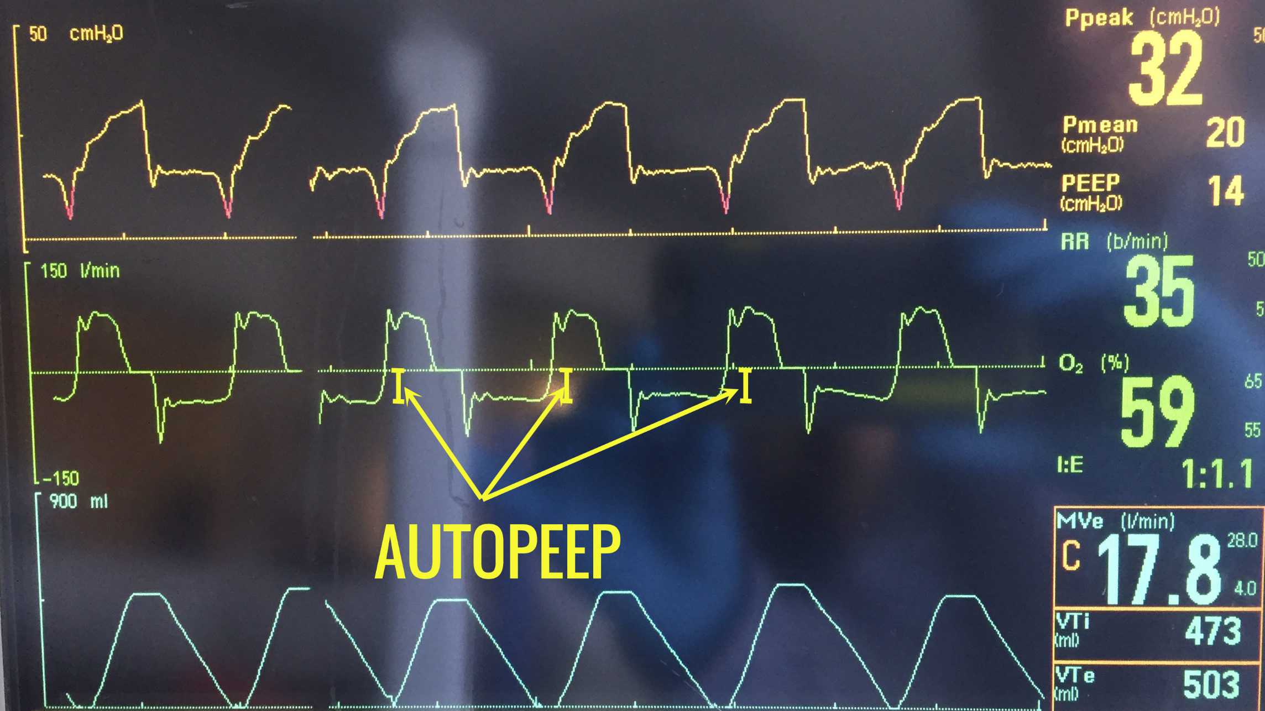
Case 2
63 yo M hx COPD on 3L home O2 p/w worsening shortness of breath
Intubated
VCAC 450 / 30 / 5 / 60
Called to room for hypotension
38
5

Slide 34
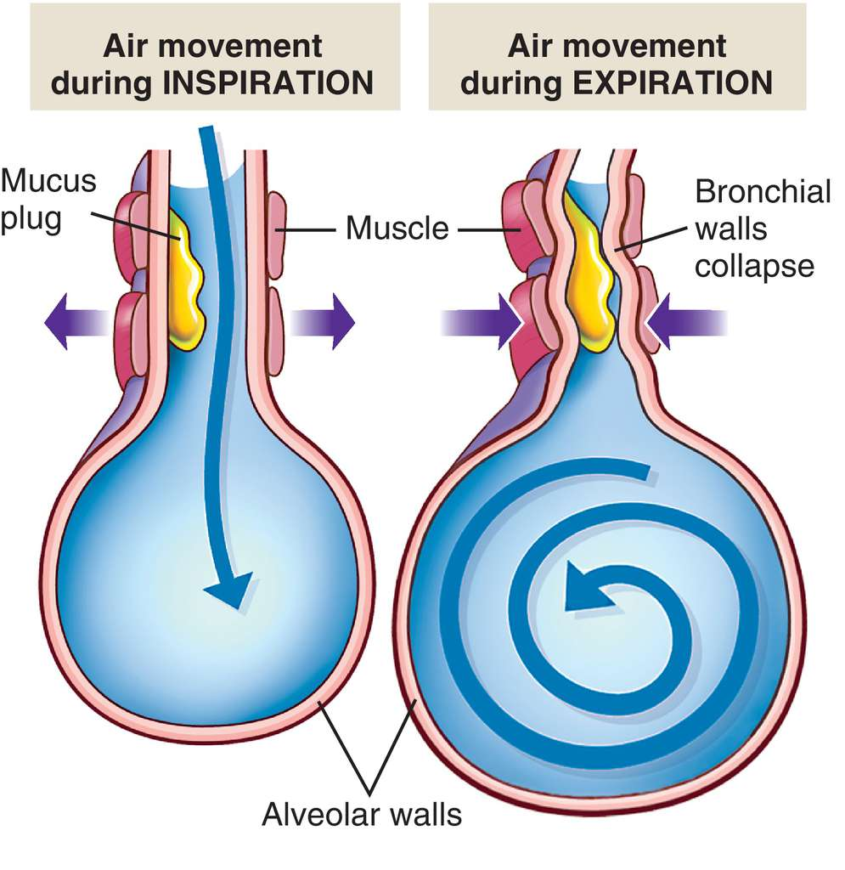
Air trapping, Auto PEEP
Buildup of residual volume
Intrinsic physiology (COPD, bronchospasm)
Short expiratory times
Double triggering, dyssynchony
⬆ intrathoracic pressure → thoracic compartment syndrome

Slide 35
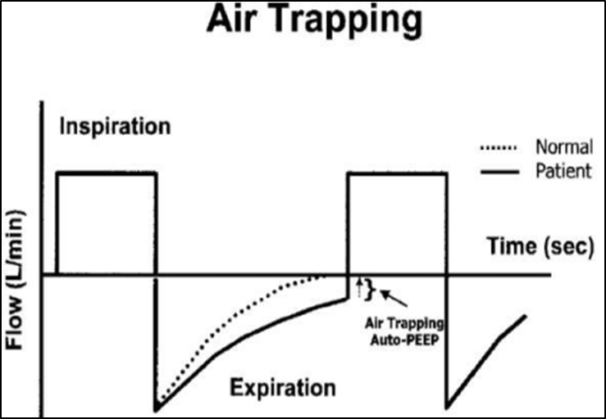
Combating Auto PEEP
Perform end inspiratory hold
Treatment:
Shortening Insp Time (inc flow)
Lengthening Exp Time (decrease RR)
Bronchodilators
Sedation, pain?

Slide 36
Case 2
45 minutes later, called back to room
Patient increasing WOB
Dyssynchronous

Slide 37
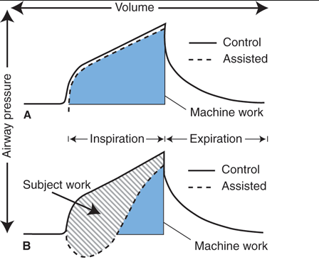
Scalloping, sucking down
Seen in volume control
Patient wants
Higher flow
Higher volumes
Increased WOB
Treat by:
Increasing flow
Increasing TV
Switch to PC

Slide 38
Treat scalloping, suck down
Treat by:
Increasing flow
Increasing TV
Switch to PC

Slide 39
Remember…
PIP, Pplat relationship
PIP > Pplat → think obstruction, increased resistance
PIP ≈ Pplat → think worsening compliance, stiffer lungs
Look at wave forms
Exhalation curve should return to baseline
Inhalation pressures should be linear or flat

Slide 40
Goals of Mechanical Ventilation
Goals of Oxygenation
SpO2 88 – 95%
PaO2 55 – 80mmHg
FiO2 < 60%
Goals of Ventilation
6 – 8cc/kg IBW
pH ~ 7.25 – 7.3
Goals of Mechanics
Driving pressure (DP) < 14cm H2O
Pplat < 30cm H20
PIP < 40cm H2O if possible
Synchronous flow loops

Slide 41
Thank You!!!
Questions?????

